Slide 1
CSci 3130
Software Architectures

Slide 2
Software Architecture
What is a Software Architecture?
The description of the structure of a software system, which is composed of software elements, their externally visible properties and their relationships to each other.
Software system design at the highest level.
Closely related to Software Design – boundaries are very fuzzy.
Iterative and incremental
There is no one unique architecture for a given problem
Why do we need it?

Slide 3
Understanding and Communication
Software systems are too complex
Abstraction of details
Break a complex system into smaller, less complex sub-systems (Divide & Conquer)
Individual sub-systems are better understood
50% of your time you deal with people who probably don't understand you.

Slide 4
Reuse
Identifying the individual parts of the system facilitates encapsulation
Encapsulation facilitates reuse
Many small problems have been solved before
Sub-systems are designed and implemented for a specific purpose / task with generalized interfaces
Generalized interfaces allow the reuse of the same sub-system in a different complex system
Software Product Lines
The more reuse, the less money it costs, the safer your job

Slide 5
Construction and Evolution
Individual sub-systems and well defined interfaces allow:
Independent development of multiple sub-systems in parallel by different teams
Independent testing of multiple sub-systems with much less test cases
Replace one implementation of a sub-system with another implementation
Easily estimate the impact of a change
You won't get it right the first time → software evolves

Slide 6
Analysis
Up-front analysis prevents undesired surprises:
Design decisions
Performance requirements
Reliability
Usability
Does each sub-system satisfy its specific requirements? Under which conditions?
Implementation restrictions
Hardware
Storage
Interconnect
Support

Slide 7
Software Architecture Models
Various formal models / frameworks exist:
4+1
RM-ODP
SOMF
IEEE 1471-2000 – ISO/IEC 42010-2007 (standards)
Languages to describe the architecture:
Acme
Wright
UML
Pick and choose
All have in common: Views

Slide 8

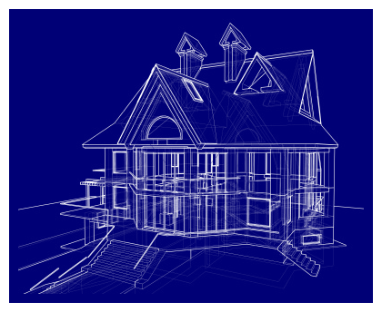
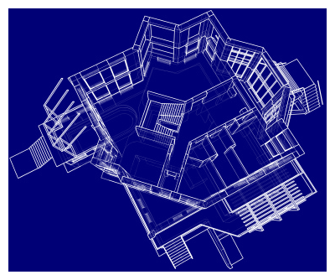
Architecture Views

Slide 9
Architecture Views
Description of the architecture from different perspectives (viewpoints)
Facilitates communication:
Business Owner
Client
Software Designer
Developer
System Builder
Everyone has their own vocabulary

Slide 10
View model or Viewpoints
A view is a representation of a whole system from the perspective of a related set of concerns
A view model or viewpoints framework defines a coherent set of views to be used in the construction of a system architecture, software architecture, or enterprise architecture.

Slide 11
Example Views
Some examples of kinds of views (viewpoints in the 1471/42010 ontology) are:
Functional/logical viewpoint
Code/module viewpoint
Development/structural viewpoint
Concurrency/process/runtime/thread viewpoint
Physical/deployment/install viewpoint
User action/feedback viewpoint
Data view/data model

Slide 12
Types of Architecture Views
Component & Connector View
Very universal, easy to understand, high-level
Module View
Often the result of the software design
Allocation
Used by integrators and system engineers

Slide 13

Component & Connector View
Graph-like diagram of the parts of a system and their relationships
Parts = Components
Relationships = Connectors

Slide 14
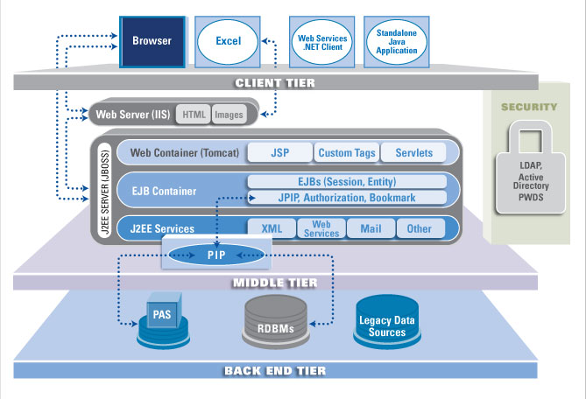
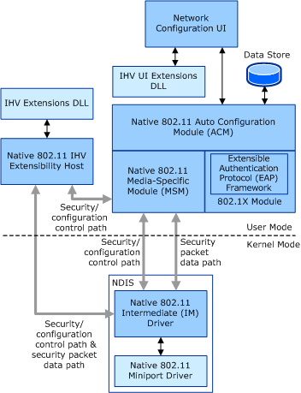
Component & Connector View

Slide 15

Components
Units of computation or data storage
Distinct names – Choose them wisely!
Components have types, the C&C view shows specific instances
Interfaces (ports) to communicate with other components
Describe components independent of the system

Slide 16

Component Types

Slide 17
Connectors
Connect components that interact with each other
Distinct names – Choose them wisely!
All communication between components is done through connectors – not only remote.
Mechanisms:
Function call
RPC
Broker-based
Provided and implemented by middleware
Beware: Easily slips into the component implementation!

Slide 18
Connectors
Middleware connects components
Hardware (CPU instructions)
OS infrastructure (pipes, shared-memory)
Domain specific middleware (CORBA, HTTP, etc.)
Different communication patterns and protocols
Point-to-point
Broadcast
Multicast
HTTP / REST
CORBA (IIOP), SOAP
AMQP
Use different notation for different types of connectors

Slide 19

Connectors

Slide 20
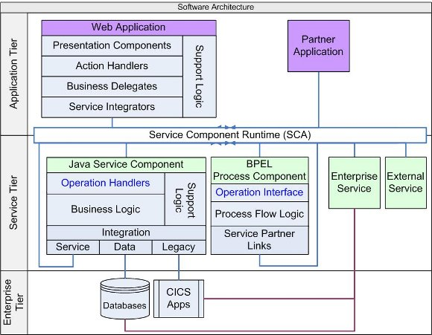
Modular View
Often logical
Often combined with a component/ connector view
Can be a software design view

Slide 21
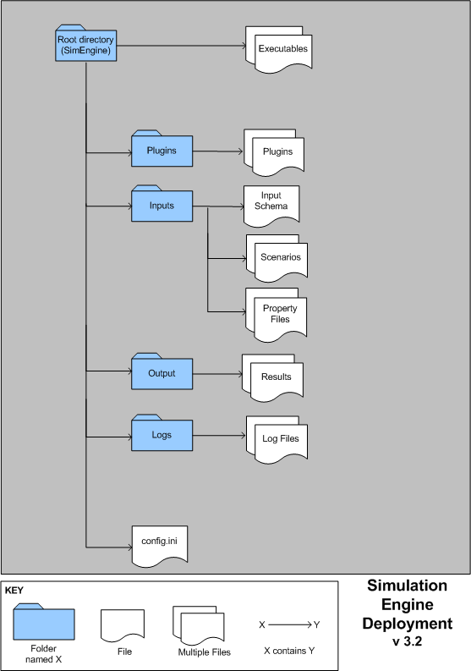
Allocation View
Describes the allocation of functional objects to computational components within the system, permits analysis of performance and used to verify satisfaction of requirements
Often used by integrators and system engineers

Slide 22
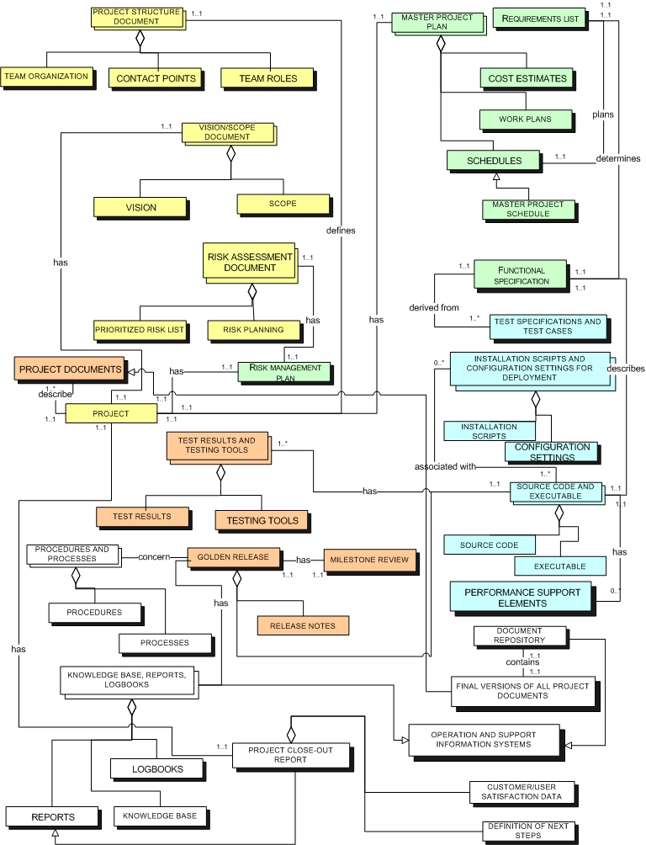
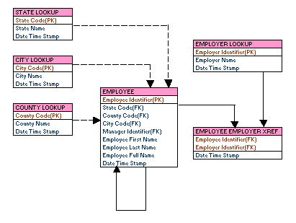
Data View
The data model
May be relational, may not

Slide 23
Example: Student Survey

Slide 24
Architecture Styles
Design Patterns for Software Architectures
Best practices to solve common problems
Architecture is a combination of many
Module View (Software Design):
Decomposition
Uses
Generalization
Layered

Slide 25
Examples of architectural styles and patterns
http://en.wikipedia.org/wiki/Software_architecture
Blackboard
Client–server model (2-tier, n-tier, Peer-to-peer, cloud computing all use this model)
Database-centric architecture (broad division can be made for programs which have database at its center and applications which don't have to rely on databases, E.g. desktop application programs, utility programs etc.)
Distributed computing
Event-driven architecture (Implicit invocation)
Front end and back end
Monolithic application
Peer-to-peer
Pipes and filters
Plug-in (computing)
Representational State Transfer
Rule evaluation
Search-oriented architecture
Service-oriented architecture (A pure SOA implements a service for every data access point.)
Shared nothing architecture
Software componentry
Space based architecture
Structured (Module-based but usually monolithic within modules)
Three-tier model (An architecture with Presentation, Business Logic and Database tiers)

Slide 26

Pipe & Filter
Producer-consumer pattern
Good encapsulation
Asynchronous processing at each component
Pipe connector responsible for synchronization
Parallel processing (Map/Reduce)
Document processing, signal processing, ETL

Slide 27

Shared-data
Data repository + data accessors
Communication through data repository
Data repository responsible for data consistency and synchronization
Add / remove components easily
Passive / active data repositories
Database applications, Web applications

Slide 28

Client-Server
Client requests a response
Response is generated by an action executed by the server
Client waits for response
Server itself might be a client
Often stateless
Client initiated
Lightweight clients
WWW, HTTP, REST

Slide 29

Publish-Subscribe
Producers publish messages on a shared medium (e.g. message bus)
Consumers subscribe to certain types of messages
Brokers may connect independent bus systems
Scalable, transaction safe, easily extensible
IRC, ESB, AMQP

Slide 30

Peer-to-Peer
Like client-server, but every component is both client and server
Intermediate components can act as proxies and/or caches
Distribution of load
Highly scalable for specific applications
ICP, CDNs, BitTorrent, Gnutella, etc.

Slide 31
Discussion
Architecture Integrity:
Why you should listen to the architect?
Architecture Analysis:
What can you learn from an architecture?
Architecture Documentation:
How to communicate an architecture?

Slide 32
Architecture Integrity
Why listen to the architect?
Architecture imposes constraints
Constraints allow to make assumptions in other parts of the system
If the constraints are not respected, other parts of the system may no longer be compatible
Deviation impacts communication, evolution, reuse, analysis

Slide 33

Example: Word Count
Intended Architecture:

Slide 34

Example: Word Count
Deviating Implementation 1:

Slide 35

Example: Word Count
Deviating Implementation 2:

Slide 36
Architecture Documentation
Diagrams are not sufficent documentation
Documentation needs to satisfy all stakeholders
Primary goal is to communicate the architecture:
Structure and formulate the documentation with that in mind

Slide 37
Architecture Documentation
Sample Outline:
Context (diagram)
How does the system fit into its environment?
Who interacts with the system?
Relevant Views (C&C, module, allocation)
Diagram
Describe the elements/components in the view in detail
Describe the interfaces between elements/components
Rationale for the decisions reflected in the architecture
Describe behaviour and processes
Combine views if suitable (e.g. C&C + allocation)

Slide 38
Architecture Documentation
Formal languages:
Acme
Wright
UML (good choice for diagrams)
English works too
Don't constrain yourself
Use whatever gets the point across.
Don't overload it
One cloud is enough, and it does not need to be sparkly.

Slide 39
Architecture Analysis & Evaluation
Significant impact on qualitative properties:
Performance
Reliability
Modifiability
Portability
More important than decisions at the implementation level:
A faster sorting algorithm only makes the chosen architecture faster, but not better.
Evaluate an architecture w.r.t. individual properties

Slide 40
Architecture Analysis & Evaluation
Formal simulation models can help:
Difficult to capture all the information to have a representative model.
Better choice for increasing system complexity (cost ↔ benefit)
Alternative: Procedural Approach
List attributes to be evaluated
Assign an experience-based subjective assessment of the quality to each attribute (e.g. letter grades)

Slide 41
ATAM Architectural Tradeoff Analysis Method
Developed by the Software Engineering Institute at the Carnegie Mellon University
Goal: help choose a suitable architecture for a software system by discovering trade-offs and sensitivity points
“Just” another semi formal inspection process...

Slide 42
ATAM Architectural Tradeoff Analysis Method
Collect Scenarios
Use Cases, Error Cases, Exceptional Cases (e.g. high load)
Attributes of interest
Collect Requirements and Constraints
Check SRS for QoS requirements/expectations for each use case / attribute
Find quantitative measures
Describe architectures that are subject to analysis
Analyze attributes w.r.t. Requirements
Identify Sensitivity and Tradeoffs
Points with most significant impact when changes
Impact on other components
Developed by the Software Engineering Institute at the Carnegie Mellon University

Slide 43
What Viewpoints for Your Project?
Functional/logical viewpoint?
Code/module viewpoint?
Development/structural viewpoint?
Concurrency/process/runtime/thread viewpoint?
Physical/deployment/install viewpoint?
User action/feedback viewpoint?
Data view/data model?

